Slide 1
Unix Commands and Shell Scripting concepts

Slide 2
Introduction
Unix operating system is a set of programs that act as a link between the computer and the user.
The computer programs that allocate the system resources and coordinate all the details of the computer's internals is called the operating system or the kernel.
Users communicate with the kernel through a program known as the shell.
Solaris Unix, AIX, HP Unix and BSD are a few examples of unix variants. Linux is also a flavor of Unix which is freely available.

Slide 3
Continued …
Several people can use a Unix computer at the same time; hence Unix is called a multiuser system.
A user can also run multiple programs at the same time; hence Unix is a multitasking environment.
All the data of Unix is organized into files. All files are then organized into directories. These directories are further organized into a tree-like structure called the filesystem.

Slide 4
Basic commands
1) Change Password : passwd
2) Listing Directories and Files : ls –l (e.g: $ls dirname )
3) Who Are You?: whoami
4) Who is Logged in? : users, who
5) Creating Files: vi editor to create ordinary files on any Unix system
(e.g: $ vi filename)
6) Display Content of a File: cat ( e.g: $ cat filename )

Slide 5
Continued….
7) Counting Words in a File: wc ( e.g: $ wc filename)
8) Copying Files : cp ( e.g: $ cp source_file destination_file)
9) Renaming Files : mv (e.g: $ mv filename newfile)
10) Deleting Files : rm ( e.g: $ rm filename)

Slide 6
Important Directories
1) Root directory : /
2) Home directory : ~
3) Parent directory : .. ( double dots is used for parent directory)
4) Current directory : . (. Single dot represents the current working directory)

Slide 7
Absolute/Relative Pathnames
Directories are arranged in a hierarchy with root (/) at the top.
Elements of a pathname are separated by a /.
A pathname is absolute, if it is described in relation to root, thus absolute pathnames always begin with a /
Relative pathnames never begin with /.
pwd command is used to print the current working directory

Slide 8
Creating/Removing/Changing Directories
1) $ mkdir dirname
2) $ rmdir dirname
3) $ cd dirname
4) $ mv dirname1 dirname2 ( to rename dirname1 to dirname2)
Note − To remove a directory, make sure it is empty which means there should not be any file or sub-directory inside this directory.

Slide 9
Unix — File Permission / Access Modes
File ownership is an important component of Unix that provides a secure method for storing files. Every file in Unix has the following attributes –
Owner permissions − The owner's permissions determine what actions the owner of the file can perform on the file.
Group permissions − The group's permissions determine what actions a user, who is a member of the group that a file belongs to, can perform on the file.
Other (world) permissions − The permissions for others indicate what action all other users can perform on the file.

Slide 10
The Permission Indicators
While using ls -l command, it displays various information related to file permission as follows
− $ls -l /home/amrood
-rwxr-xr-- 1 amrood users 1024 Nov 2 00:10 myfile
drwxr-xr--- 1 amrood users 1024 Nov 2 00:10 mydir
the first column represents different access modes, i.e., the permission associated with a file or a directory.
The permissions are broken into groups of threes, and each position in the group denotes a specific permission, in this order: read (r), write (w), execute (x) −
The first three characters (2-4) represent the permissions for the file's owner. For example, -rwxr-xr-- represents that the owner has read (r), write (w) and execute (x) permission.
The second group of three characters (5-7) consists of the permissions for the group to which the file belongs. For example, -rwxr-xr-- represents that the group has read (r) and execute (x) permission, but no write permission.
The last group of three characters (8-10) represents the permissions for everyone.

Slide 11
Changing permissions
chmod (change mode) command. There are two ways to use chmod — the symbolic mode and the absolute mode.
Using chmod in Symbolic Mode
chmod Operator | Description
+ | Adds the designated permission(s) to a file or directory
- | Removes the designated permission(s) from a file or directory.
= | Sets the designated permission(s).

Slide 12
Continued..(explaination with example)
$ls -l testfile
-rwxrwxr-- 1 amrood users 1024 Nov 2 00:10 testfile
$chmod o+wx testfile
$ls -l testfile
–rwxrwxrwx 1 amrood users 1024 Nov 2 00:10 testfile
$chmod u-x testfile
$ls -l testfile
-rw-rwxrwx 1 amrood users 1024 Nov 2 00:10 testfile
$chmod g=rx testfile
$ls -l testfile
-rw-r-xrwx 1 amrood users 1024 Nov 2 00:10 testfile

Slide 13
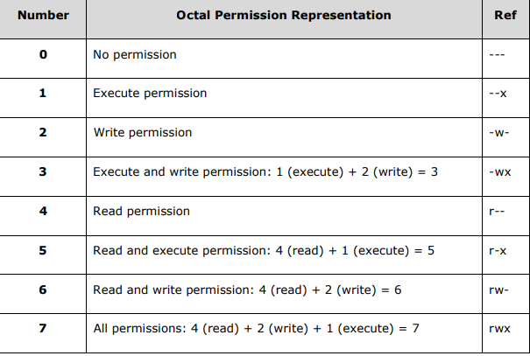
Using chmod with Absolute Permissions

Slide 14
Examples:
Here's an example using the testfile. Running ls -1 on the testfile shows that the file's permissions are as follows:
$ls -l testfile
-rwxrwxr-- 1 amrood users 1024 Nov 2 00:10 testfile
Then each example chmod command from the preceding table is run on the testfile, followed by ls –l, so you can see the permission changes
$ chmod 755 testfile
$ls -l testfile
-rwxr-xr-x 1 amrood users 1024 Nov 2 00:10 testfile
$chmod 743 testfile Unix 33
$ls -l testfile
-rwxr---wx 1 amrood users 1024 Nov 2 00:10 testfile
$chmod 043 testfile
$ls -l testfile
----r---wx 1 amrood users 1024 Nov 2 00:10 testfile

Slide 15
Changing Owners and Groups
While creating an account on Unix, it assigns a owner ID and a group ID to each user. All the permissions mentioned above are also assigned based on the Owner and the Groups.
Two commands are available to change the owner and the group of files −
• chown − The chown command stands for "change owner" and is used to change the owner of a file.
• chgrp − The chgrp command stands for "change group" and is used to change the group of a file.

